Slide 1


SOFTWARE ENGINEERING (Week-4)
Usama Musharaf
MS-CS (Software Engineering)
Lecturer (Department of Computer Science)
FAST-NUCES Peshawar

Slide 2
Agenda of week # 4
Requirement Analysis (Cont…)
Object Oriented Analysis
Modeling with UML (Static and Dynamic Models)
Discussion on Assignment # 2

Slide 3
Analysis Modeling (Cont…)

Slide 4
Elements of the Analysis Model
Object-oriented Analysis
Structured Analysis
Scenario-based
modeling
Flow-oriented
modeling
Use case text
Use case diagrams
Activity diagrams
Data structure diagrams
Data flow diagrams
Class-based
modeling
Behavioral
modeling
Class diagrams
CRC models
Collaboration diagrams
State diagrams
Sequence diagrams

Slide 5
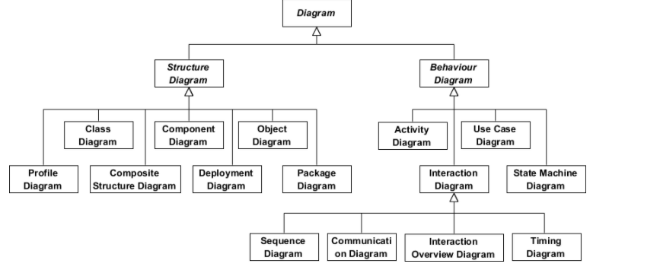

Slide 6
Scenario-Based Modeling

Slide 7
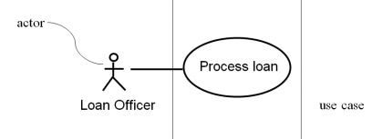
Developing Use Cases
– Define the set of actors that will be involved in the story
Actors are people, devices, or other systems that use the system or product within the context of the function and behavior that is to be described
Actors are anything that communicate with the system or product and that are external to the system itself

Slide 8
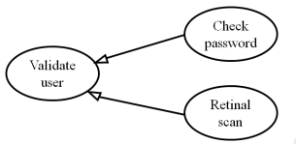
Specialized Use Cases
You may have two specialized children of this use case (Check password and Retinal scan).

Slide 9

Include
Include relationship is used to avoid describing the same flow of events several times, by putting the common behavior in a use case of its own
This is an example of dependency

Slide 10
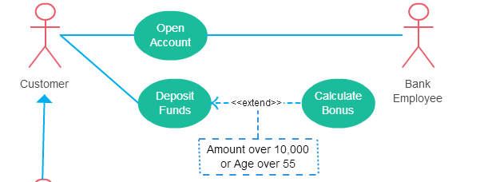
Extend
The extending use case is usually optional and can be triggered conditionally. In the diagram, you can see that the extending use case is triggered only for deposits over 10,000 or when the age is over 55.

Slide 11
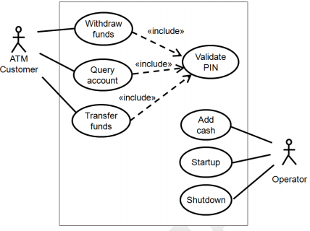
Use case diagram for atm

Slide 12
Use Case Example
Name | Validate PIN
Summary | System validates customer PIN
Dependency | none
Actors | ATM Customer
Preconditions | ATM is idle, displaying a Welcome message.
Flow of Events | Activity Diagram
Alternatives | If the system does not recognize the card, the card is ejected. If the system determines that the card date has expired, the card is confiscated. If the system determines that the card has been reported lost or stolen, the card is confiscated. If the customer-entered PIN does not match the PIN number for this card, the system re-prompts for PIN. If the customer enter the incorrect PIN three times, the system confiscates the card. If the customer enters Cancel, the system cancels the transaction and ejects the card
Post condition | Customer PIN has been validated.

Slide 13
Behavioral Modeling

Slide 14
Activity diagram
An activity diagram in the use-case model can be used to capture the activities and actions performed in a use case.
It expresses the dynamic aspect of the system.

Slide 15
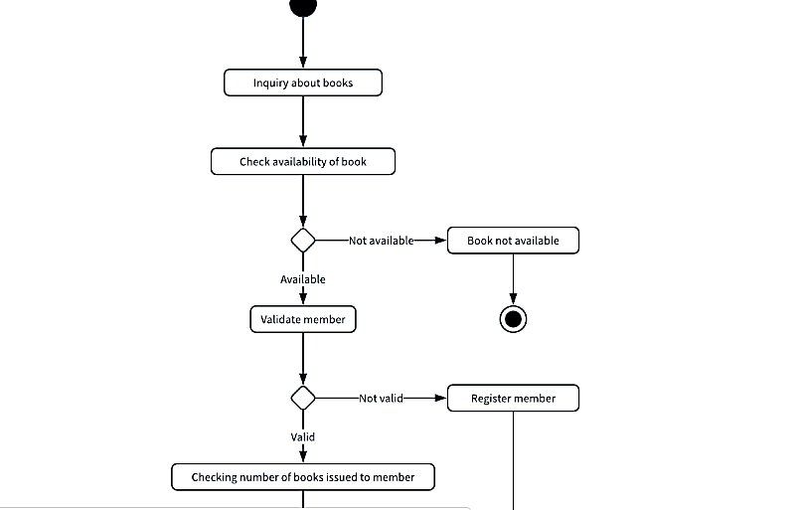
Activity diagram

Slide 16
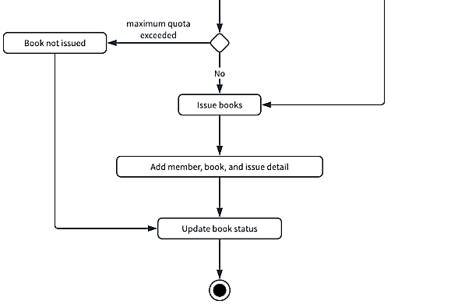
Activity diagram

Slide 17
Swimlane diagram
Mapping Who Does What to Whom
You are assigning a responsibility to an actor.
Note, we did not say to an object - to an actor.

Slide 18
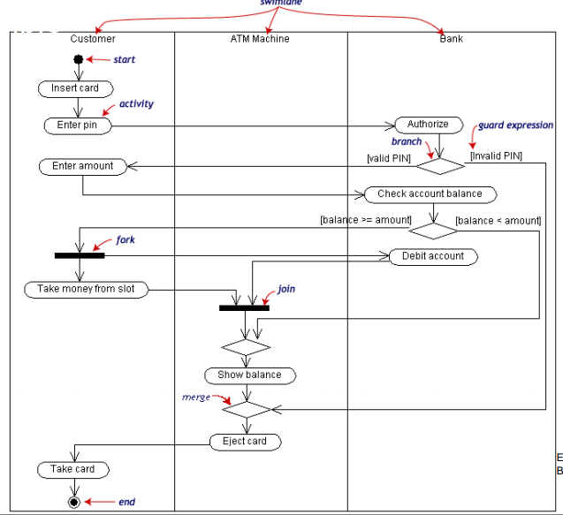
Swimlane Diagram

Slide 19
State Machine Diagram
A state machine diagram models dynamic behavior.
It specifies the sequence of states in which an object can exist:
The events and conditions that cause the object to reach those states.
The actions that take place when those states are reached.

Slide 20
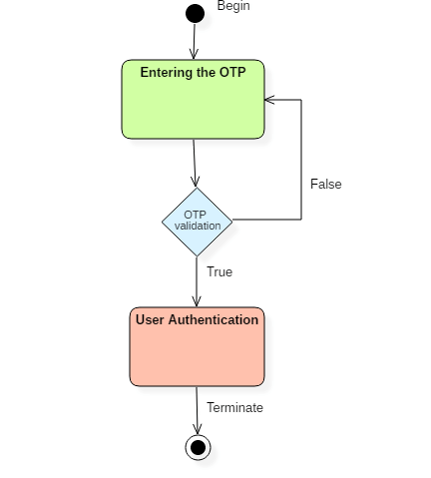
Element of State Machine Diagram
States
Events
Transition
An object has state, behavior, and a unique identity.
An object goes through various states during its lifespan.

Slide 21
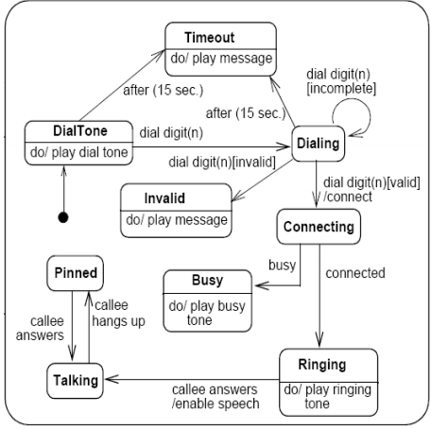
State Machine Diagram

Slide 22
Sequence diagram
A sequence diagram shows object interactions.
It depicts the objects involved in the scenario and the sequence of messages exchanged between the objects needed to carry out the functionality of the scenario.

Slide 23
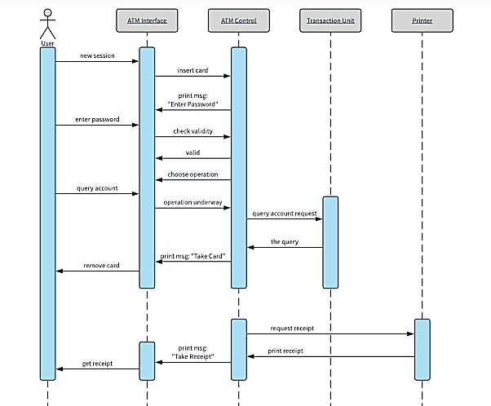

Slide 24
System Sequence Diagram

Slide 25
Structured Analysis of Object oriented Paradigm

Slide 26
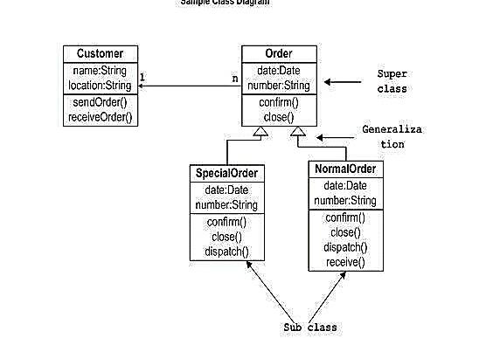
Class Diagram

Slide 27
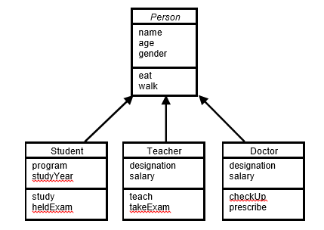
Inheritance
Advantages of Inheritance
Reuse
Less redundancy
Increased maintainability

Slide 28
Kinds of Association
There are two main types of association which are then further subdivided i.e.
Class Association
Object Association

Slide 29
Class Association
Class association is implemented in terms of Inheritance.
Inheritance implements generalization/specialization relationship between objects.
Inheritance is considered class association.

Slide 30
Object Association
It can be of one of the following types,
Simple Association
Composition
Aggregation

Slide 31
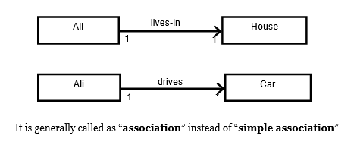
Simple Association

Slide 32
Kinds of Simple Association
Simple association can be categorized in two ways,
With respect to direction (navigation)
With respect to number of objects (cardinality)

Slide 33
Kinds of Simple Association w.r.t Navigation
With respect to navigation association has the following types,
One-way Association
Two-way Association

Slide 34
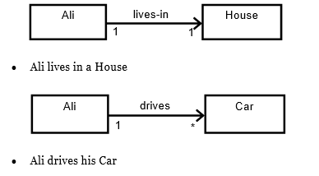
One-Way Association
In one-way association we can navigate along a single direction only, it is denoted by an arrow towards the server object.
Examples:

Slide 35
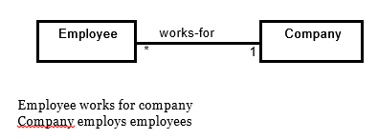
Two-Way Association
In two-way association we can navigate in both directions, it is denoted by a line between the associated objects.
Example:

Slide 36
Kinds of Simple Association w.r.t Cardinality
With respect to cardinality association has the following types,
Binary Association
Ternary Association
N-ary Association

Slide 37
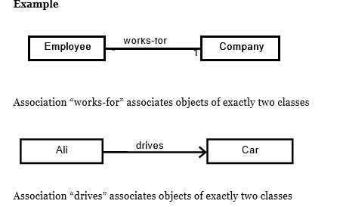
Binary Association
It associates objects of exactly two classes; it is denoted by a line, or an arrow between the associated objects.

Slide 38
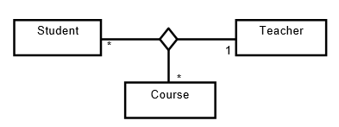
Ternary Association
It associates objects of exactly three classes; it is denoted by a diamond with lines connected to associated objects.
Example:
Objects of exactly three classes are associated

Slide 39
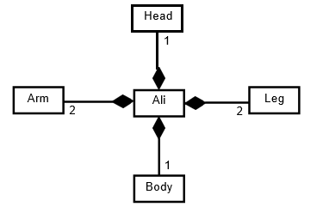
Composition
An object may be composed of other smaller objects, the relationship between the “part” objects and the “whole” object is known as Composition.
Composition is represented by a line with a filled-diamond head towards the composer object.

Slide 40
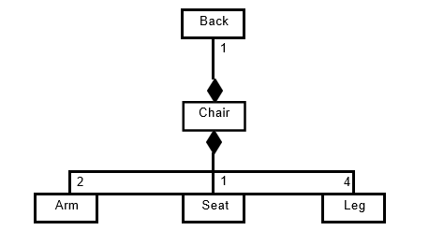
Composition
Composition of chair:

Slide 41
Composition
Composition is stronger relationship because
Composed object becomes a part of the composer.
Composed object can’t exist independently.
Example I
Ali is made up of different body parts They can’t exist independent of Ali
Example II
Chair’s body is made up of different parts They can’t exist independently

Slide 42
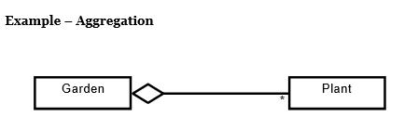
Aggregation
An object may contain a collection (aggregate) of other objects, the relationship between the container and the contained object is called aggregation,
Aggregation is represented by a line with unfilled-diamond head towards the container.

Slide 43
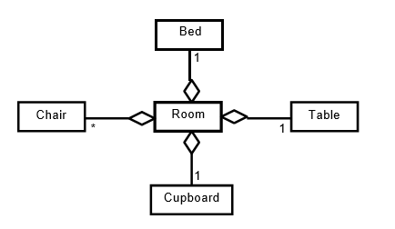
Aggregation

Slide 44
Aggregation
Aggregation is weaker relationship because
Aggregate object is not a part of the container
Aggregate object can exist independently
Example I
Furniture is not an intrinsic part of room
Furniture can be shifted to another room, and so can exist independent of a particular room
Example II
A plant is not an intrinsic part of a garden
It can be planted in some other garden, and so can exist independent of a particular garden

Slide 45
Polymorphism
It is also essential component of object oriented modeling (paradigm).
In general, polymorphism refers to existence of different forms of a single entity.
For example, both Diamond and Coal are different forms of Carbon.
In OO model, polymorphism means that different objects can behave in different ways for the same message (stimulus).

Slide 46
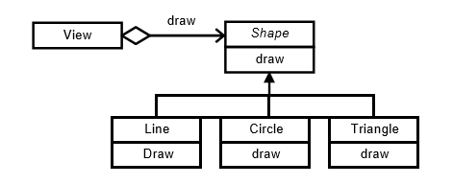
Polymorphism

Slide 47
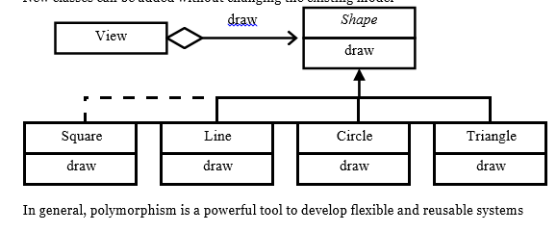
Polymorphism Advantages
Messages can be interpreted in different ways depending upon the receiver class.
New classes can be added without changing the existing model.

Slide 48
Assignment # 1
Create a working plan for banking system case study using agile process model (Extreme programming). You are required to
Identify functional requirements (FR’s) from the case study and write User Stories for each FR in order to have detail understanding.
Create Iteration Plans.
Perform Test First Development (Write test descriptions for user story cards).

Slide 49
Assignment # 2
You are required to create a SRS (Software Requirement Specification) document for banking system case study. Steps for creating SRS,
After capturing functional requirements through user-story cards, state non-functional requirements as well for banking system.
Requirement Analysis
User Stories card would help you to capture use-cases. Identify actors from story cards and draw use-cases for a banking system case study.
Draw Activity Diagram to capyure detail functionalities by elaborating your use cases.
Draw Swimlane Diagram to link activities with actors.
Specification
After Analysis, write final set of requirements.

Slide 50
HAVE A GOO DAY!

